Slide 1

Predicting & Preventing Customer Churn
A data-driven churn analysis for a telecom business
Python (Pandas, Scikit-learn) · Power BI (Dashboarding)
Tushar Vaidya
Mining Engineering, IIT (ISM) Dhanbad · Data Analytics Internship Applicant

Slide 2
The Business Problem
Telecom companies lose a significant share of subscribers every year. Acquiring a new customer costs far more than retaining one — so the earlier a business can flag who is likely to leave, the more revenue it can protect.
26.6%
of customers in this dataset churned
This project asks two questions: which customers are most likely to churn, and why — so retention efforts can be targeted, not generic.
7,032
total customers analyzed
Source: IBM Telco Customer Churn dataset (Kaggle)
2

Slide 3





End-to-End Approach
1
2
3
4
Clean
Engineer
Model
Visualize
Fixed data types, handled missing values, verified consistency
Built TenureGroup, HighRiskCustomer, AvgRevenuePerMonth & more
Trained & compared Logistic Regression vs Random Forest
Built an interactive Power BI dashboard for stakeholders
Every stage was driven by the same goal: turn raw customer records into a specific, actionable retention plan.
3

Slide 4
Feature Engineering Highlights
TenureGroup — Bucketed tenure into New / Growing / Established / Loyal to reveal lifecycle risk
HighRiskCustomer — Flags customers combining month-to-month contract, electronic check payment & no online security — an interaction Logistic Regression can't learn on its own
AvgRevenuePerMonth — Total charges normalized by tenure, isolating value independent of customer age
ServiceCount — Number of subscribed services, testing whether bundling affects loyalty
4

Slide 5

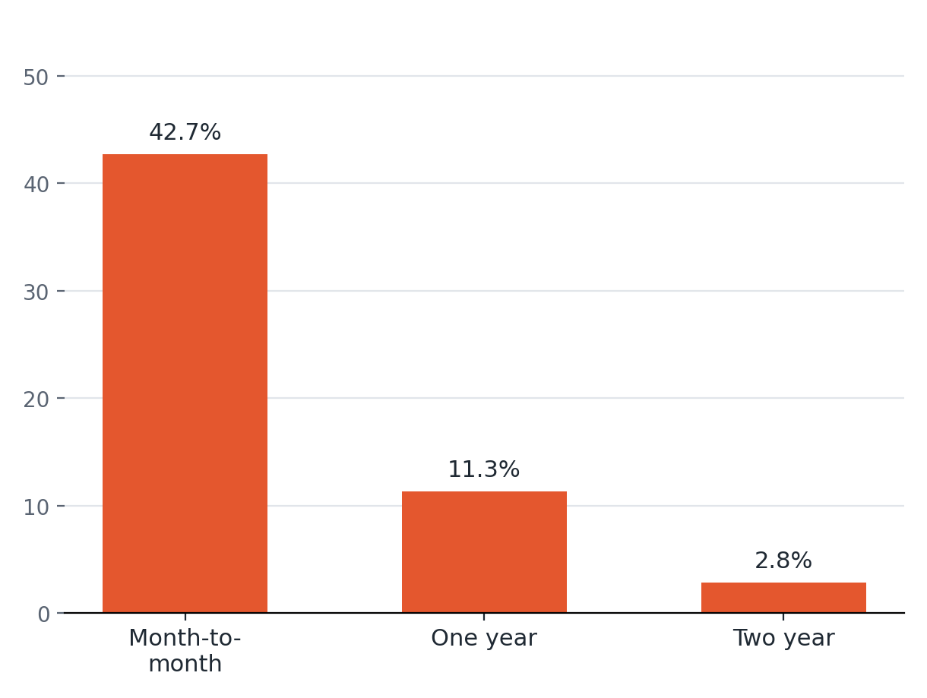
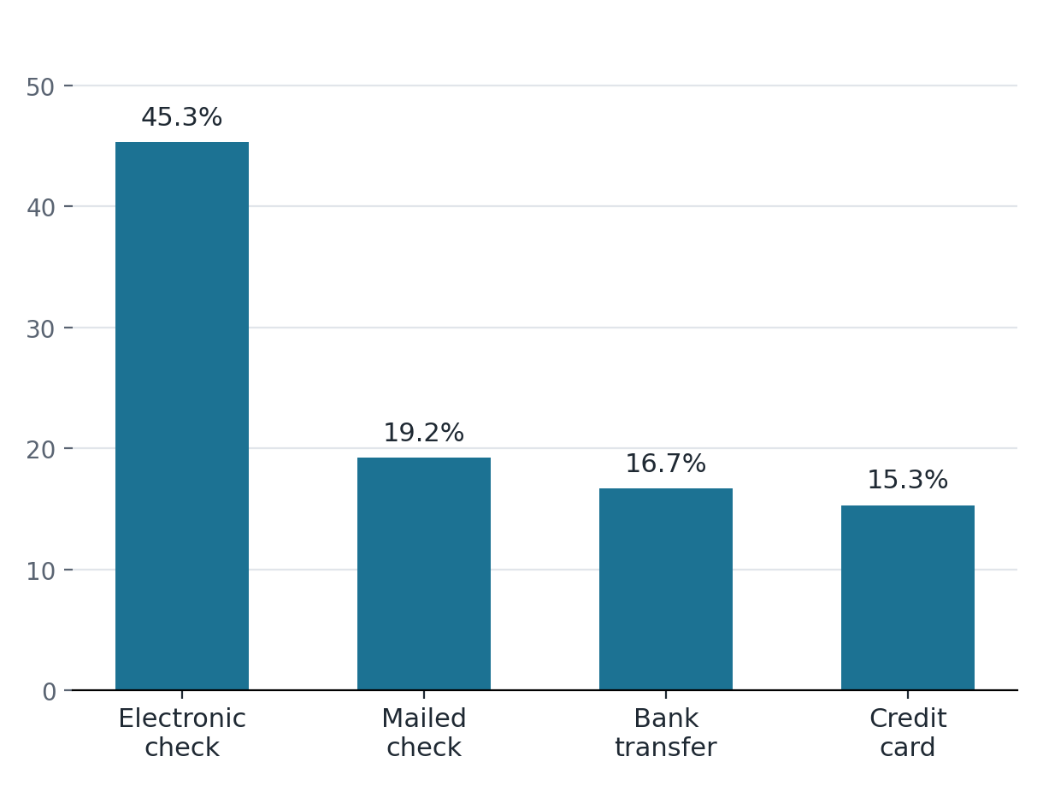
Who Is Churning? Contract & Payment
Churn rate by contract type (%)
Churn rate by payment method (%)
5

Slide 6
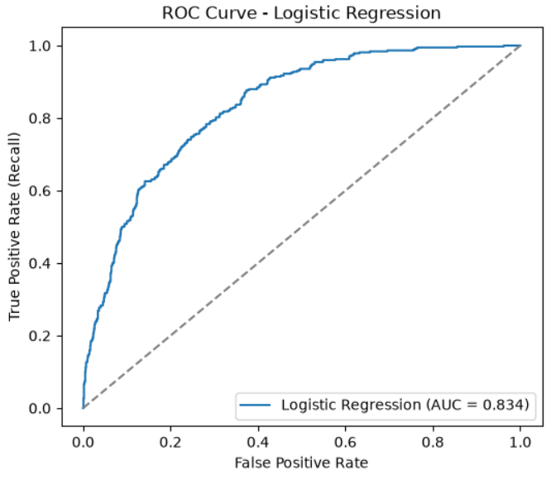
Modeling: Logistic Regression vs Random Forest
Metric | Logistic Regression | Random Forest
Accuracy | 79.32% | 78.39%
ROC-AUC | 0.834 | —
Churn-class recall | 54% | 50%
Logistic Regression was selected as the final model — a very similar accuracy to Random Forest, but with a materially better ROC-AUC and more interpretable coefficients for a business audience.
6

Slide 7

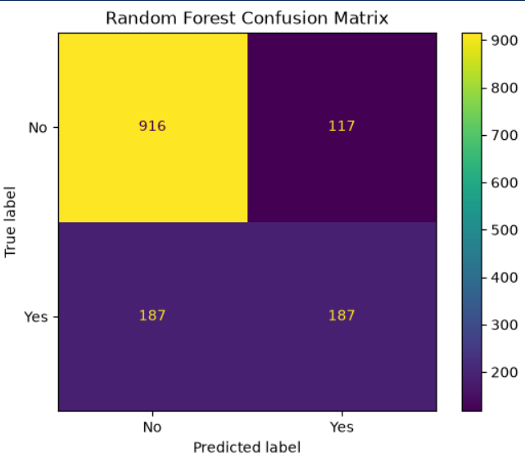
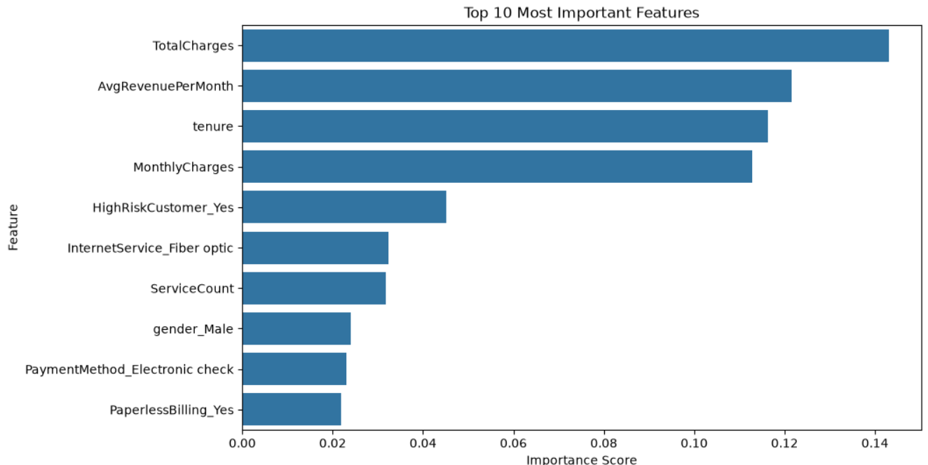
Model Interpretations
Random Forest Confusion Matrix
Top Drivers of Churn (Feature Importance)
7

Slide 8
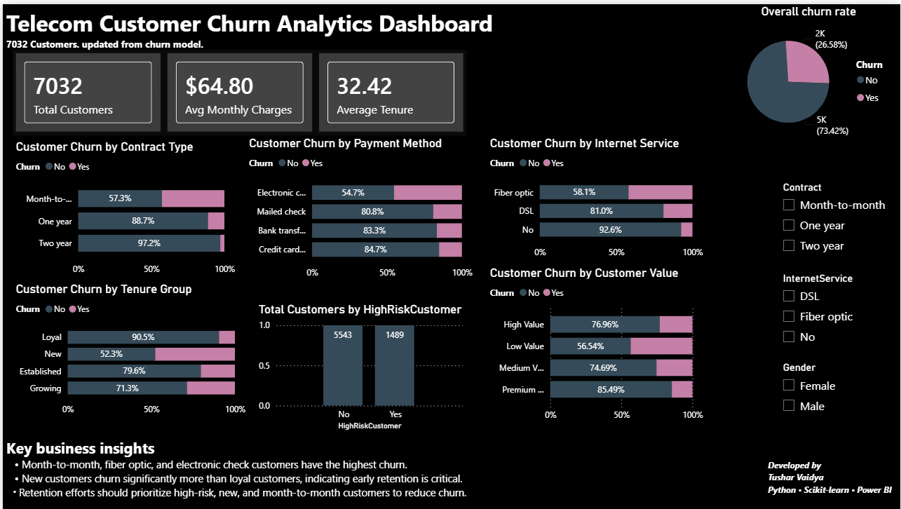
From Prediction to Business Decision
The analysis was translated into an interactive Power BI dashboard, so non-technical stakeholders can filter by contract, service, and demographic to explore churn risk themselves.
8

Slide 9

Business Recommendations
Target month-to-month customers first
1
They churn at 42.7% vs. 2.8% for two-year contracts — the single biggest lever available.
Fix the electronic check experience
2
45.3% churn rate vs. ~15-19% for other payment methods — investigate friction or trust issues in that flow.
Prioritize the first 12 months
3
New customers churn ~5x more than loyal ones — early onboarding and check-ins matter most.
Watch the high-risk segment closely
4
Customers combining month-to-month + electronic check + no online security are compounding multiple risk factors at once.
9

Slide 10

What I'd Do Next
Run 5-fold cross-validation to confirm the model comparison holds beyond one train/test split
Test an ablation: does removing binned duplicate features (TenureGroup, CustomerValue) change performance?
Tune the classification threshold to trade precision for recall — missing a churner costs more than a false alarm
Extend the SQL layer once this data lives in a relational database, for repeatable aggregation pipelines
10

Slide 11

Thank You
Happy to walk through the notebook, the SQL equivalents, or the dashboard live.
Tushar Vaidya
Mining Engineering, IIT (ISM) Dhanbad
GitHub: https://github.com/TusharVaidya2410 · Email: 24je0471@iitism.ac.in

